Slide 1


Python – Functions (Modularization)

Slide 2
Highlights!
Function – Definition, example.
Why using Functions??!!
Function arguments / parameters.
Function return value.
Scope of variables - Local and global variables.
generators

Slide 3
Function
DEFINITION

Slide 4
Function
A function is a block of organized, reusable code that is used to perform a single, related action / task.
Functions provide better modularity for your application and a high degree of code reusing.
Built-in functions in Python: print(), input(), type(), bin(), and many many more ….
User-defined functions: you can define a function as per the need.

Slide 5
Function - Syntax
Function blocks begin with the keyword def
Function name
Passing inputs / parameters (Any input parameters) to the function
def functionname ( parameters ):
"function_docstring"
function_suite
return [expression]
The code block within every function starts with a colon (:)
[Optional] the documentation string of the function
The code block inside function must be indented
Returning value from function when it ends [Optional]

Slide 6
Function - Example
def functionname ( parameters ):
"function_docstring"
function_suite
return [expression]
def addition(num1, num2):
"This function adds two numbers and returns the value"
num1 = int(num1)
num2 = int(num2)
result = num1 + num2
return result

Slide 7
Function – Calling a function
def addition(num1, num2):
"This function adds two numbers and returns the value"
result = int(num1) + int(num2)
return result
n1 = input('Enter number1:')
n2 = input('Enter number2:')
res = addition(n1,n2)
print('Result is: ', res)
Function named “addition”
Outside of the function body

Slide 8
Function – Calling a function
def addition(num1, num2):
"This function adds two numbers and returns the value"
result = int(num1) + int(num2)
return result
n1 = input('Enter number1:')
n2 = input('Enter number2:')
res = addition(n1,n2)
print('Result is: ', res)
Function named “addition”
4
5
Program execution starts here
1
2
Call ‘addition’ function with
parameters
3
4
6

Slide 9

Function – Calling a function
1
2
3
4
5
6
7
8
9
10
11
12
13
def printInfo(num1, num2):
print(f'We are adding {num1} and {num2}..’)
return
def addition(num1, num2):
"This function adds two numbers and returns the value"
result = int(num1) + int(num2)
return result
n1 = input('Enter number1:')
n2 = input('Enter number2:')
printInfo(n1,n2)
res = addition(n1,n2)
print('Result is: ', res)
Can u explain the code??

Slide 10

Why using Functions??

Slide 11
Functions provide a couple of benefits:
Reusability - Functions allow the same piece of code to run multiple times
Modularity - Functions break long programs up into smaller components
Portability - Functions can be shared and used by other programmers

Slide 12
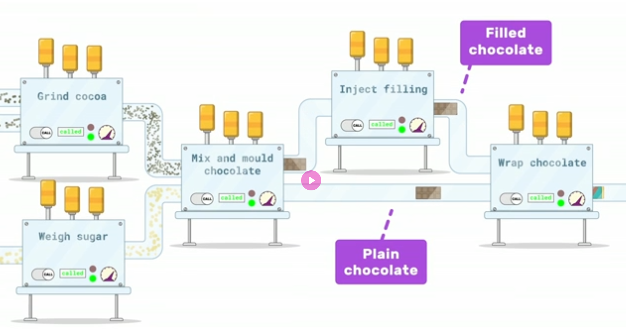
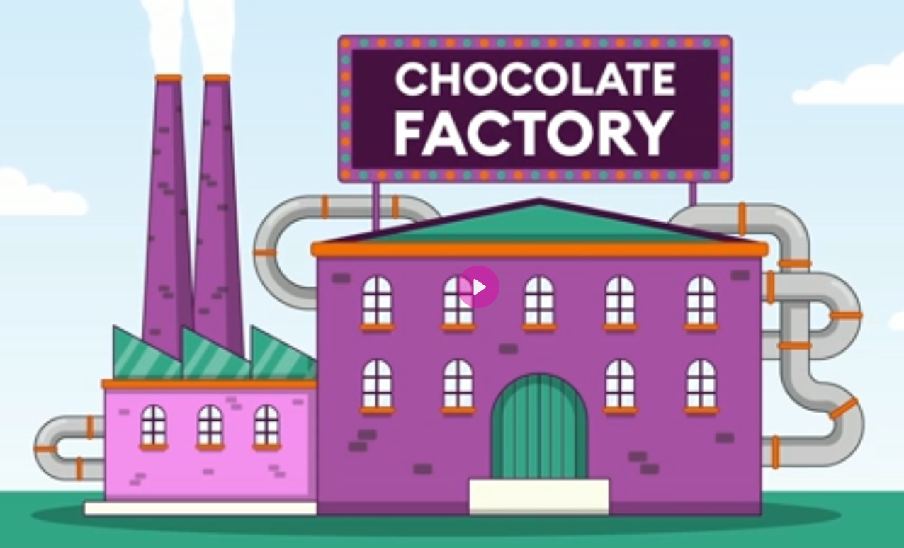
Why using Functions??
REF: https://www.futurelearn.com/info/courses/programming-102-think-like-a-computer-scientist/0/steps/53095

Slide 13
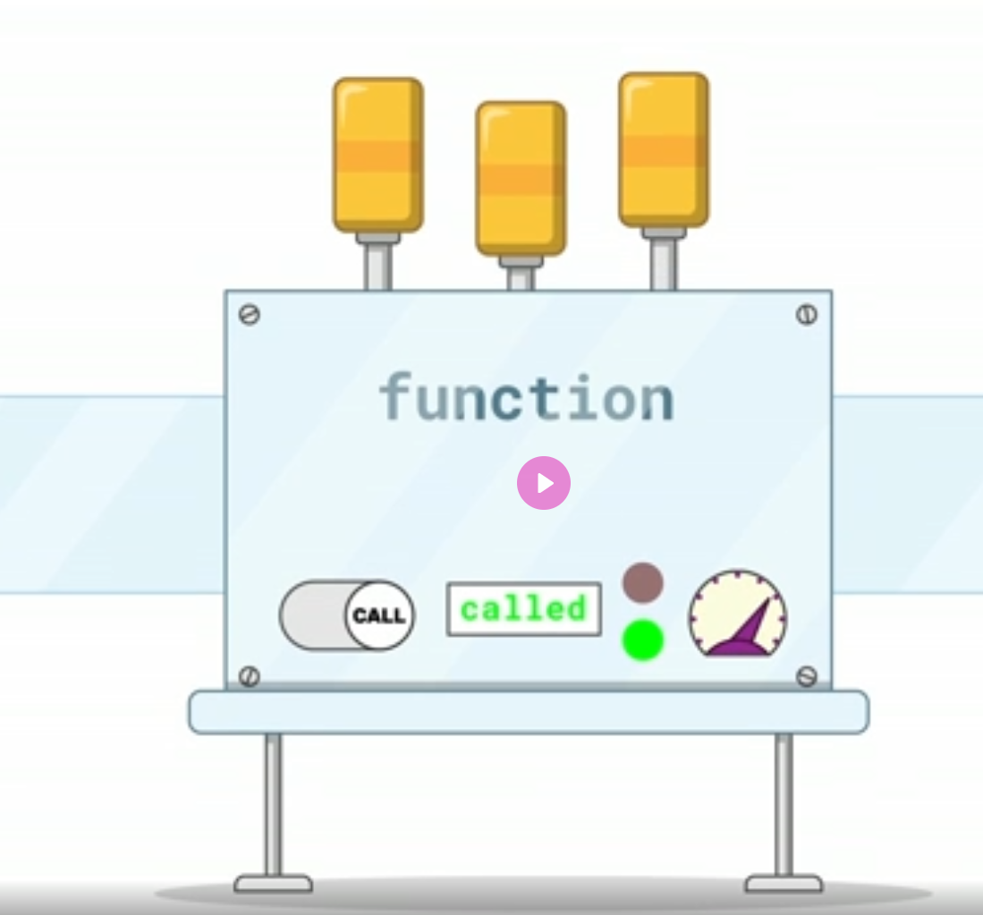
Why using Functions??
Each unit is a function
Does a specific task.
Repetitive.
Takes specific input.
Process.
Produce specific output
REF: https://www.futurelearn.com/info/courses/programming-102-think-like-a-computer-scientist/0/steps/53095

Slide 14
Why using Functions??
Each unit is a function
Does a specific task.
Repetitive.
Takes specific input.
Process.
Produce specific output
Modular
Reusable
Portable
REF: https://www.futurelearn.com/info/courses/programming-102-think-like-a-computer-scientist/0/steps/53095

Slide 15
Why using Functions??
Lets take a very simple programming example now..
You are supposed to add 5 numbers.. Taking two numbers at a time and adding them..
How this problem can be coded!!?

Slide 16

Why using Functions??
You are supposed to add 5 numbers.. Taking two numbers at a time and adding them..
n1 = input('number: ')
n2 = input('number: ')
add = int(n1) + int(n2)
n3 = input('number: ')
add += int(n3)
n4 = input('number: ')
add += int(n4)
n5 = input('number: ')
add += int(n5)
print('Result is: ', add)
Is this a smart solution???

Slide 17
Why using Functions??
You are supposed to add 5 numbers.. Taking two numbers at a time and adding them..
n1 = input('number: ')
n2 = input('number: ')
add = int(n1) + int(n2)
n3 = input('number: ')
add += int(n3)
n4 = input('number: ')
add += int(n4)
n5 = input('number: ')
add += int(n5)
print('Result is: ', add)
def getInput():
n = input('Enter number: ')
return int(n)
def addnumber(n1, n2):
return n1+n2
add = addnumber(getInput(), getInput())
add = addnumber(add, getInput())
add = addnumber(add, getInput())
add = addnumber(add, getInput())
print('Result is: ', add)

Slide 18
Function Arguments / Parameters
Passing inputs / parameters (Any input parameters) to the function
def functionname ( parameters ):
"function_docstring"
function_suite
return [expression]

Slide 19
Function Arguments / Parameters
You can call a function by using the following types of formal arguments-
Required arguments
Keyword arguments
Default arguments
Variable-length arguments

Slide 20
Required arguments
Required arguments are the arguments passed to a function in correct positional order.
The number of arguments in the function call should match exactly with the function definition.
def printme( str, name ):
"This prints a passed string into this function"
print (str , name)
return
# Now you can call printme function
printme()
printme("This is me with name")
printme('This is me, ', 'My name is Rajit.')
line 7, in <module>
printme()
TypeError: printme() missing 2 required positional arguments: 'str' and 'name'
line 8, in <module>
printme()
TypeError: printme() missing 1 required positional arguments: 'name'
What about this call??

Slide 21
Keyword arguments
Keyword arguments are related to the function calls.
When use keyword arguments in a function call, the caller identifies the arguments by the parameter name.
def printinfo( name, age ):
"This prints a passed info into this function"
print ("Name: ", name)
print ("Age ", age)
return
# Now you can call printinfo function
printinfo( age=50, name="miki" )
printinfo(age=50, "miki" )
printinfo(age = 30)
Keyword argument!
Produce Error!!!

Slide 22
Default arguments
A default argument is an argument that assumes a default value if a value is not provided in the function call for that argument.
def printinfo( name = 'Rajit', age = 35):
"This prints a passed info into this function"
print ("Name: ", name)
print ("Age ", age)
return
# Now you can call printinfo function
printinfo( age=50, name="miki" )
printinfo( name = 'Samah')
printinfo()
Name: miki
Age 50
Name: Samah
Age 35
Name: Rajit
Age 35

Slide 23
Variable-length arguments
Some time we need to pass variable number of arguments to the function.
These arguments are called variable-length arguments.
An asterisk (*) is placed before the variable name. It holds the values as tuple.
def printinfo( arg1, *vartuple ):
"This prints a variable passed arguments"
print ('Required argument: ', arg1)
print ('variable arguments: ')
for var in vartuple:
print (var)
return
# Now you can call printinfo function
printinfo( 70, 60, 'Rajit' )
printinfo( 10 )
Required argument: 70
variable arguments:
60
Rajit
Required argument: 10
variable arguments:

Slide 24
Function return
Statement
def functionname ( parameters ):
"function_docstring"
function_suite
return [expression]
Returning value from function when it ends [Optional]

Slide 25
Function return Statement
The statement return [expression] exits a function.
Optionally passing back an expression to the caller.
A return statement with no arguments is the same as return None.
def printinfo( name = 'Rajit', age = 35):
"This prints a passed info into this function"
print ("Name: ", name)
print ("Age ", age)
return
# Now you can call printinfo function
printinfo( age=50, name="miki" )
def func():
n1 = 20
n2 = 'Rajit'
return [n1,n2]
n3 = func()
print(n3[0], n3[1])
Function func() returns a tuple of values
Function printinfo() returns nothing

Slide 26
Scope of Variables

Slide 27
Scope of variable – Global or Local
Local variable: Variables that are defined inside a function body have a local scope.
Global Variable: Variables defined outside any function have a global scope.
Local variables are accessible only inside the function in which they are declared.
Global variables can be accessed throughout the program body by all functions.

Slide 28
Scope of variable – Global or Local
Local variable: Variables that are defined inside a function body have a local scope.
Global Variable: Variables defined outside any function have a global scope.
def afunction():
n3 = 35
return
def functest():
n1 = 'This is local variable'
return
n2 = 'This is global variable'
Local Variable
Local Variable
Global Variable

Slide 29
Scope of variable – Global or Local
def afunction():
n3 = 35
print('local n3 = ', n3)
print('Global (inside function) n2= ', n2)
return
n2 = 'This is global variable'
afunction()
print('Global (outside function) n2= ', n2)
print('Local of afunction() n3: ', n3)
Can you trace the output?
local n3 = 35
Global (inside function) n2= This is global variable
Global (outside function) n2= This is global variable
Traceback (most recent call last): functionargument.py",
line 51, in <module>
print('Local of afunction() n3: ', n3)
NameError: name 'n3' is not defined. Did you mean: 'n2'?

Slide 30
Generators
A generator function in Python is defined like a normal function, but whenever it needs to generate a value, it does so with the yield keyword rather than return.
If the body of a def contains yield, the function automatically becomes a Python generator function.
The generator has the following syntax in Python:
def function_name():
yield statement

Slide 31
Generator Example
1 # A generator function that yields 1 for first time,
2 # 2 second time and 3 third time
3 def simpleGeneratorFun():
4 yield 1
5 yield 2
6 yield 3
7 # Driver code to check generator function
8 for value in simpleGeneratorFun():
9 print(value)
Output:
1
2
3

Slide 32
Generator Example (Fibonacci)
1 # A simple generator for Fibonacci Numbers
2 def fib(limit):
3 # Initialize first two Fibonacci Numbers
a= 0
b=1
6 # One by one yield next Fibonacci Number
7 while a < limit:
8 yield a
c= a+b
a = b
b = c
11 # Create a generator object
12 x = fib(5)
13 print(next(x))
14 print(next(x))
15 print(next(x))
16 print(next(x))
17 print(next(x))
18 # Iterating over the generator object using for in loop
19 print("\nUsing for in loop")
20 for i in fib(5):
21 print(i)
Output:
0
1
1
2
3
Using for in loop
0
1
1
2
3

Slide 33
Problem Set!

Slide 34
Write a Python function to find the Max of two numbers.
Write a Python function to check whether a number falls in a given range. The function will take 3 numbers as input, first one the number to be checked, 2nd and 3rd number for range.
Write a Python function that takes a number as a parameter and check whether it is even or odd.

Slide 35
Suppose you have started working on an hourly basis as a librarian in your institution. You want to know how much you will earn a month given that you know how many hours you will work per week and how much you receive per hour. However, whatever amount you earn per month will have 20% of it deducted and that amount will be instead used to pay part of your tuition fees. Write a program that finds out the earnings before and after the deduction. Also find out the yearly earnings (without deduction) and how much of your tuition fees you are paying yourself annually. Assume that there are 4 weeks per month.
Enter the number of hours you will work per week: 20
Enter the amount you earn per hour: BDT. 150
Monthly earning: BDT. 12000
Monthly earning after deduction: BDT. 9600
Yearly earning: BDT. 144000
Amount paid as tuition fees per year: BDT. 28800
Write a function named calculateEarning() that will calculate the monthly earning, earning after deduction, yearly earning and amount to be paid as tuition fees.
calculateEarning() function should take weekly hour and earning per hour as parameters.

